Slide 1
Game-Oriented Learning
Valkanova V., Valkanov V.

Slide 2
Introduction
Game-oriented education, supported in the Virtual Education Space
Described in details in the PhD Thesis: V. Valkanova “Virtual Education Space for the Secondary School”

Slide 3
Game-Based Learning
Game-based learning (GBL) is a type of game play that has defined learning outcomes;
Generally, game based learning is designed to balance subject matter with game play and the ability of the player to retain and apply said subject matter to the real world;

Slide 4
Motivation
Increasing attractiveness and creativity of the students;
Simplifying the complex matter;
A good way of testing acquired knowledge;
Personalized education;

Slide 5
DeLC Infrastructure

Slide 6
To extend the current structure
Game Agent (GA):
Hold and control the game logic and user game play;
Transparent for the student;
Collect personal information for the player – strategy, typical mistakes;
Adapt the game according the requirements of the teacher
Personal Agent (PA):
analyzing information from GA (about players);
Make conclusions about mistakes, make plans for the next game steps (educational issues);

Slide 7
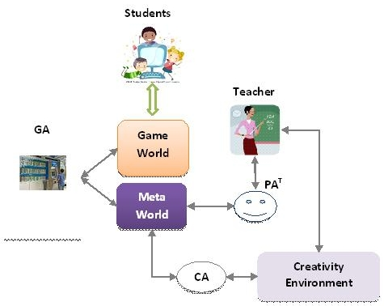
Architecture

Slide 8
Agents’ Environment
Divided in two parts:
Game World – virtual 3D world, which is visible for the players and GA. The games are presented here.
Meta World – invisible for the players. Here different type of information is recorded (game results, data used for personalization and adaptation). Communication with the PA of teachers and CA (Creativity Agent). Interface to the Creativity Environment.

Slide 9
First game - prototype
The player navigate avatar, bike or car in city environment to check his knowledge about traffic rules.
The task is to pass over a specific ( or random generated ) route.
There is a specific control points on the route – crossing, traffic lights etc.
At the specific points different type of questions (tests) are presented.

Slide 10
GA
Rational agent (bounded rationality)
  Deliberation: determine the goal (intention) using the mental states (Beliefs, Desires, Intention)
  Means-end-reasoning (planning): select (generate) a suitable test complied the current intention
    Test are saved in the Digital Library (DiLibs) of the space

Slide 11
Basic BDI architecture of GA
Environment : 3D world, different way of movement, static or random generated routes, control points and traffic rules.
Beliefs: reached control points.
Desires: possible events (or situation) related to the control point.
Intention: an event from the desires (e.g. randomly selected).

Slide 12
Thank you!

